Slide 1
A Generalized Model for Stream Processing
and
Apache Beam
Notes:
Frances and Tyler
talk about Apache Beam -- unified model for batch and stream data processing

Slide 2
Acknowledgements
Most of the Slides in this talk have been adapted from the following sources:
Frances Perry, Tyler Akidau, of Google, Apache Beam Committers, “Fundamentals of Stream Processing with Apache Beam”, QCon, San Francisco, Nov. 2016, https://goo.gl/yzvLXe
Kenneth Knowles of Google, Apache Beam PMC, “Unified, Portable, Efficient Batch and Stream Processing with Apache Beam,” Strata San Jose, CA, 2017, https://goo.gl/sRxNxF
https://2021.beamsummit.org/sessions/state-apache-beam/
Copyright belongs to the original authors.

Slide 3
How to deal with Infinite, Delayed, Out-of-Order Data Streams (e.g. from Global, Distributed Sources?)
Notes:
talk about the shape of data
running example analyzing mobile game logs
users around the globe crushing candy
want to analyze these logs to learn about game...

Slide 4
Incoming!
Score per user?

Slide 5
Data Can be Unbounded, Delayed, Out of Order...
8:00
8:00
8:00
14:00
13:00
12:00
11:00
10:00
9:00
8:00
Notes:
Lets look at some points that were scored at 8am
<animate> red score 8am, received quickly
<animate> yellow score also happened at 8am, received at 8:30 due to network congestion
<animate> green element was hours late. this was someone playing in airplane mode on the plane. had to wait for it to land.
so now we’ve got an unordered, infinite data set, how do we process it...

Slide 6
Different Ways to Organize the Data Streams
8:00
8:00
8:00

Slide 7
Event Time vs. Processing Time
Event Time
Rogue One III.5
Episode IV
Episode V
Episode VI
Episode I
Episode II
Episode III
Episode VII
Episode VIII
The Rise of
Skywalker
1977
1980
1983
1999
2002
2005
2015
2016
2017
Processing Time

Slide 8
Event Time vs. Processing Time
Event Time
Rogue One III.5
Episode IV
Episode V
Episode VI
Episode I
Episode II
Episode III
Episode VII
Episode VIII
The Rise of
Skywalker
1977
1980
1983
1999
2002
2005
2015
2016
2017
Processing Time

Slide 9
Aggregating via Event-Time Windows
Input
Processing Time
10:00
11:00
12:00
13:00
14:00
15:00
Output
Event Time
10:00
11:00
12:00
13:00
14:00
15:00
Notes:
reorganize data base on when they occurred, not when they arrived
red element arrived relatively on time and stays in the noon window.
green that arrived at 12:30, was actually created about 11:30, so it moves up to the 11am window.
requires formalizing the difference between processing time and event time

Slide 10
Aggregating via Processing-Time Windows
8:00
9:00
10:00
11:00
12:00
13:00
14:00
Processing Time
Notes:
when doing aggregations, need to divide the infinite stream of elements into finite sized chunks that can be processed independently.
simplest way using arrival time in fixed time periods
can mean elements are being processed out of order,
late elements may be aggregated with unrelated elements that arrived about the same time...

Slide 11
Historical analysis
Thursday
Wednesday
Tuesday

Slide 12
Data Processing Tradeoffs
$$$
Completeness
Latency
Cost

Slide 13
What is important for your application?
Important
Not Important
Completeness
Low Latency
Low Cost
$$$

Slide 14
Monthly Billing
Important
Not Important
Completeness
Low Latency
Low Cost
$$$

Slide 15
Billing estimate
Important
Not Important
Completeness
Low Latency
Low Cost
$$$

Slide 16
Abuse Detection
Important
Not Important
Completeness
Low Latency
Low Cost
$$$

Slide 17
Historical Analysis
Important
Not Important
Completeness
Low Latency
Low Cost
$$$

Slide 18
Choices abound
Apache Beam
Apache Flink
Apache Hadoop
Cloud Dataflow
Apache
Spark
Apache Samza
MapReduce
(paper)
Apache
Storm
Apache Gearpump (incubating)
Apache Apex
FlumeJava
(paper)
Heron
MillWheel
(paper)
Dataflow Model
(paper)
2004
2005
2006
2007
2008
2009
2010
2011
2012
2013
2014
2015
2016
See also: Tyler Akidau's talk on Evolution of Massive-Scale Data Processing

Slide 19
The Generalized Streaming Model (aka the Dataflow/ Beam model)
What are you computing?
Where in event time?
When in processing time are results produced?
How do refinements relate?

Slide 20
The Beam Model: Asking the Right Questions
What are you computing?
Where in event time?
When in processing time are results produced?
How do refinements relate?
Aggregations, transformations, …

Slide 21
The Beam Model: What are you computing?
Sum Per User

Slide 22
The Beam Model: What are you computing?
Python
input | Sum.PerKey()
| Write(BigQuerySink(...))
Sum Per Key
Java
input.apply(Sum.integersPerKey())
.apply(BigQueryIO.Write.to(...));

Slide 23
What Where When How
What are you computing?
Element-Wise
Aggregating
Composite
Notes:
The first thing to figure out is what you are actually computing.
transform each element independently, similar to the Map function in MapReduce, easy to parallelize
Other transformations, like Grouping and Combining, require inspecting multiple elements at a time
Some operations are really just subgraphs of other more primitive operations.
Now let’s see a code snippet for our gaming example...

Slide 24
An example: Element-wise transformations
8:00
9:00
10:00
11:00
12:00
13:00
14:00
Processing Time
Notes:
Element wise transformations work on individual elements
parsing, translating or filtering
applied as elements flow past
but other transforms like counting or joining require combining multiple elements together ...

Slide 25
What Where When How
What: Computing Integer Sums
// Collection of raw log lines
PCollection<String> raw = IO.read(...); // Element-wise transformation into team/score pairs
PCollection<KV<String, Integer>> input =
raw.apply(ParDo.of(new ParseFn());
// Composite transformation containing an aggregation
PCollection<KV<String, Integer>> scores =
input.apply(Sum.integersPerKey());
Notes:
Psuedo Java for compactness/clarity!
start by reading a collection of raw events
transform it into a more structured collection containing key value pairs with a team name and the number of points scored during the event.
use a composite operation to sum up all the points per team.
Let’s see how this code executes...

Slide 26
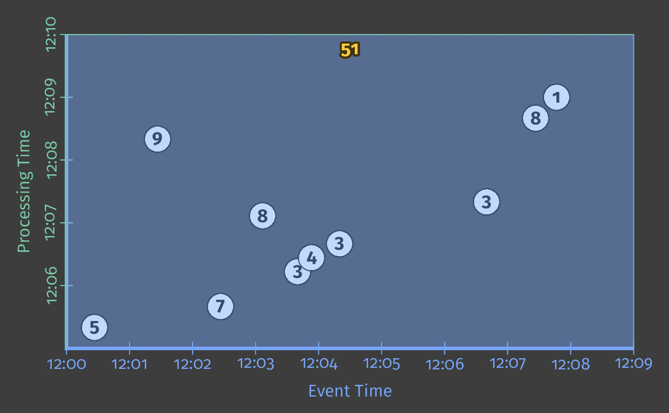
What Where When How
What: Computing Integer Sums
Notes:
time is thick white line.
accumulate sum into the intermediate state
produces output represented by the blue rectangle.
all the data available, rectangle covers all events, no matter when in time they occurred.
single final result emitted when it’s all complete
pretty standard batch processing -> let’s see what happens if we tweak the other questions

Slide 27
The Beam Model: Asking the Right Questions
Event time windowing
What are you computing?
Where in event time?
When in processing time are results produced?
How do refinements relate?

Slide 28
The Beam Model: Where in Event Time?
8:00
8:00
8:00

Slide 29
Event Time vs. Processing Time
Event Time
Rogue One III.5
Episode IV
Episode V
Episode VI
Episode I
Episode II
Episode III
Episode VII
Episode VIII
The Rise of
Skywalker
1977
1980
1983
1999
2002
2005
2015
2016
2017
Processing Time

Slide 30
Event Time vs. Processing Time
Event Time
Rogue One III.5
Episode IV
Episode V
Episode VI
Episode I
Episode II
Episode III
Episode VII
Episode VIII
The Rise of
Skywalker
1977
1980
1983
1999
2002
2005
2015
2016
2017
Processing Time

Slide 31
Processing Time vs Event Time
Processing Time
Event Time

Slide 32
Processing Time vs Event Time
This is not possible
Processing Time
Realtime
Event Time

Slide 33
Processing Time vs Event Time
Processing Delay
Processing Time
Event Time

Slide 34
Processing Time vs Event Time
Very delayed
Processing Time
Event Time

Slide 35
Processing Time windows
(probably are not what you want)
Processing Time
Event Time

Slide 36
Event Time Windows
Processing Time
Event Time

Slide 37
The Beam Model: Where in Event Time?
Python
Window Into
input | WindowInto(FixedWindows(3600)
| Sum.PerKey()
| Write(BigQuerySink(...))
Java
input.apply(
Window.into(
FixedWindows.of(
Duration.standardHours(1)))
.apply(Sum.integersPerKey())
.apply(BigQueryIO.Write.to(...))
Sum Per Key

Slide 38
What Where When How
Where: Fixed 2-minute Windows
PCollection<KV<String, Integer>> scores = input
.apply(Window.into(FixedWindows.of(Minutes(2)))
.apply(Sum.integersPerKey());
Notes:
fixed windows that are 2 minutes long

Slide 39
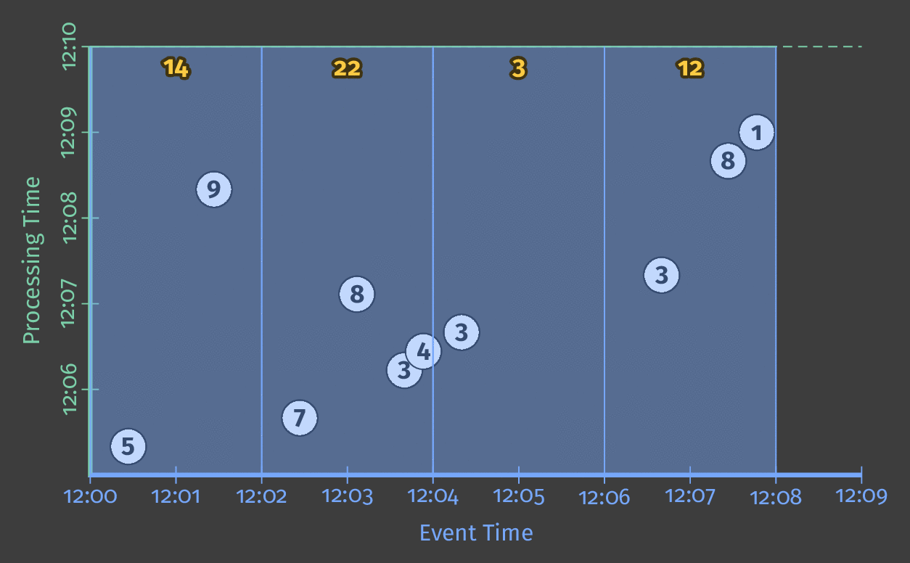
What Where When How
Where: Fixed 2-minute Windows
Notes:
independent answer for every two minute period of event time.
still waiting until the entire computation completes to emit any results. won’t work for infinite data!
want to reduce latency...

Slide 40
The Beam Model: Where in Event Time?
Assign each timestamped event to one or more windows
Merge those windows according to custom logic
Fixed Windows
(also called Tumbling)
Sliding Windows
User Sessions

Slide 41
So that's what and where...

Slide 42
Beam Model: Asking the Right Questions
What are you computing?
Where in event time?
When in processing time are results produced?
How do refinements relate?
Triggers

Slide 43
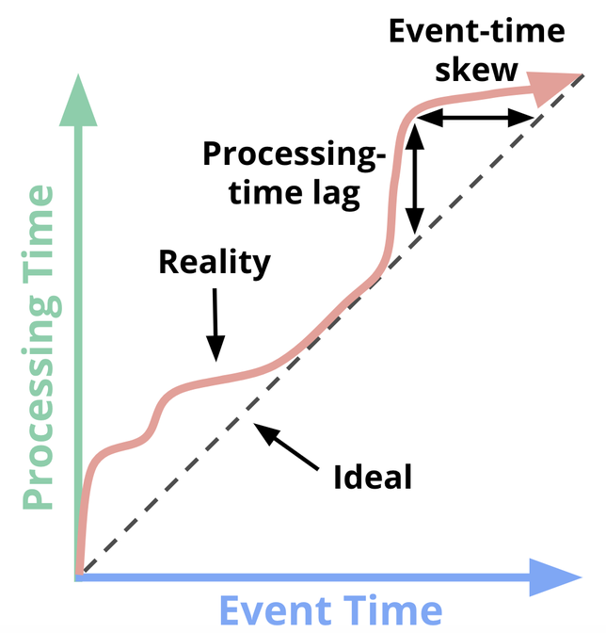
Formalizing Event-Time Skew
Notes:
Blue axis is event, Green is processing. Ideally no delay -- elements processed when they occurred
<animate> Reality looks more like that red squiggly line, where processing time is slightly delayed off event time.
<animate> The variable distance between reality and ideal is called skew. need to track in order to reason about correctness.
Processing time
The vertical distance between the ideal and the red line is the lag in the processing-time domain. That distance tells you how much delay is observed (in processing time) between when the events for a given time occurred and when they were processed. This is the perhaps the more natural and intuitive of the two skews.
Event time
The horizontal distance between the ideal and the red line is the amount of event-time skew in the pipeline at that moment. It tells you how far behind the ideal (in event time) the pipeline is currently.

Slide 44
Formalizing Event-Time Skew
Skew
Reality
Processing Time
Ideal
Event Time
Notes:
Blue axis is event, Green is processing. Ideally no delay -- elements processed when they occurred
<animate> Reality looks more like that red squiggly line, where processing time is slightly delayed off event time.
<animate> The variable distance between reality and ideal is called skew. need to track in order to reason about correctness.
Processing time
The vertical distance between the ideal and the red line is the lag in the processing-time domain. That distance tells you how much delay is observed (in processing time) between when the events for a given time occurred and when they were processed. This is the perhaps the more natural and intuitive of the two skews.
Event time
The horizontal distance between the ideal and the red line is the amount of event-time skew in the pipeline at that moment. It tells you how far behind the ideal (in event time) the pipeline is currently.

Slide 45
Formalizing Event-Time Skew
Watermarks describe event time progress.
"No (event-time) timestamp earlier than the watermark will be seen"
Skew
~Watermark
Processing Time
Ideal
Often heuristic-based.
Too Slow? Results are delayed.
Too Fast? Some data is late.
Event Time
Notes:
red line the watermark -- no event times earlier than this point are expected to appear in the future.
often heuristic based
Perfect example: sequential log files, e.g. Kafka w/ static set of partitions
Heuristic example: mobile events uploaded late after leaving airplane mode
too slow → unnecessary latency.
too fast →some data comes in late, after we thought we were done for a given time period.
how do we reason about these types of infinite, out-of-order datasets...

Slide 46
When in processing time?
Triggers control when results are emitted.
Triggers are often relative to the watermark.
Skew
~Watermark
Processing Time
Ideal
Event Time
What Where When How
Notes:
trigger define when in processing time to emit results
often relative to the watermark, which is that heuristic about event time progress.

Slide 47
Event time windows
Processing Time
Event Time

Slide 48
Fixed cutoff (we can do better)
Allowed delay
Processing Time
Event Time

Slide 49
Perfect watermark
Processing Time
Event Time

Slide 50
What Where When How
When: Triggering at the Watermark
PCollection<KV<String, Integer>> scores = input
.apply(Window.into(FixedWindows.of(Minutes(2))
.triggering(AtWatermark()))
.apply(Sum.integersPerKey());
Notes:
request that results are emitted when we think we’ve roughly seen all the elements for a given window.
actually default -- just written it for clarity.

Slide 51
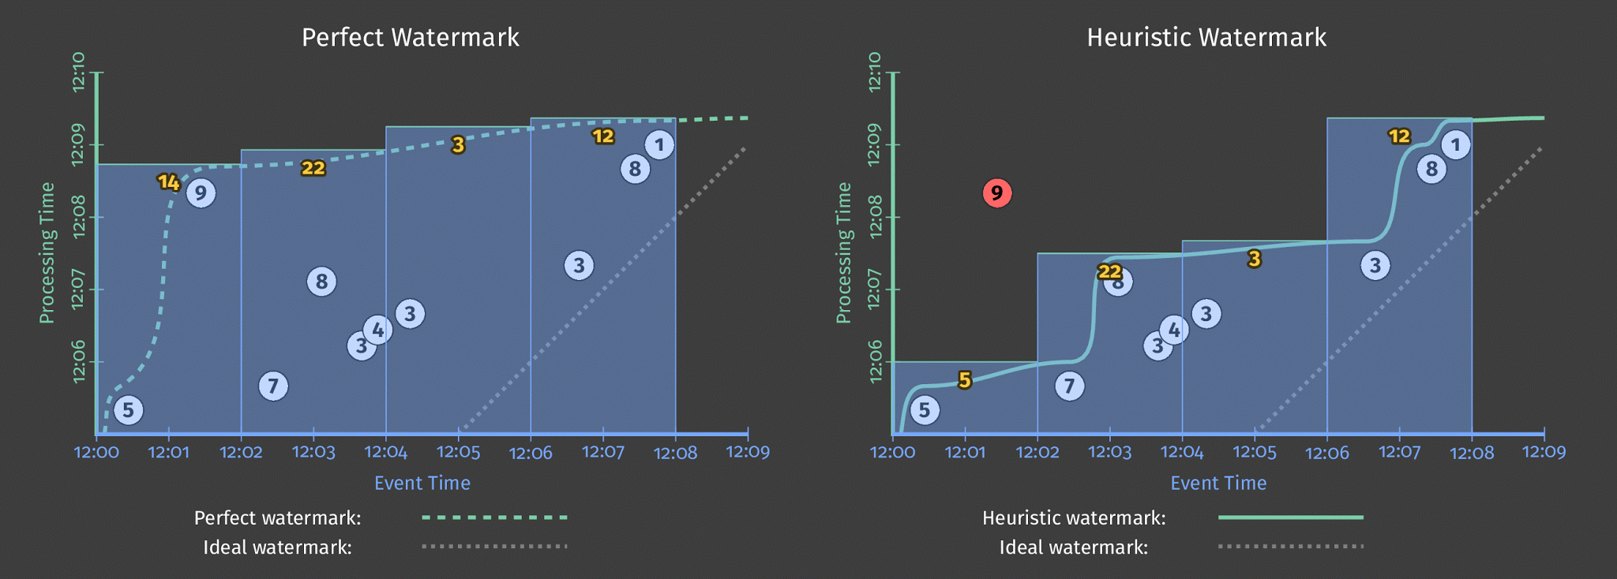
What Where When How
When: Triggering at the Watermark
Notes:
left graph shows a perfect watermark -- tracks when all the data for a given event time has arrived
emit the result from each window as soon as the watermark passes.
<animate> watermark is usually just a heuristic, so look more like graph on the right. now 9 is missed
and if the watermark is delayed, like in the first graph, need to wait a long time for anything. would like speculative.
lets use a more advanced trigger...

Slide 52
Heuristic Watermark
Processing Time
Event Time

Slide 53
Heuristic Watermark
Processing Time
Current processing time
Event Time

Slide 54
Heuristic Watermark
Processing Time
Current processing time
Event Time

Slide 55
Heuristic Watermark
Late data
Current processing time
Processing Time
Event Time

Slide 56
Watermarks measure completeness
✔ Monthly billing
$$$
✔ Historical Analysis
$$$
? Running Total
$$$
? Abuse Detection
$$$

Slide 57
The Beam Model: When in Processing Time?
Python
input | WindowInto(FixedWindows(3600),
trigger=AfterWatermark())
| Sum.PerKey()
| Write(BigQuerySink(...))
Window Into
Trigger after end of window
Java
input
.apply(Window.into(FixedWindows.of(...))
.triggering(
AfterWatermark.pastEndOfWindow()))
.apply(Sum.integersPerKey())
.apply(BigQueryIO.Write.to(...))
Sum Per Key

Slide 58
AfterWatermark.pastEndOfWindow()
Processing Time
Event Time

Slide 59
AfterWatermark.pastEndOfWindow()
Processing Time
Current processing time
Event Time

Slide 60
AfterWatermark.pastEndOfWindow()
Late data
Current processing time
Processing Time
Event Time

Slide 61
High completeness
Potentially high latency
Low cost
AfterWatermark.pastEndOfWindow()
Processing Time
$$$
Event Time

Slide 62
Repeatedly.forever(
AfterPane.elementCountAtLeast(2))
Processing Time
Event Time

Slide 63
Repeatedly.forever(
AfterPane.elementCountAtLeast(2))
Processing Time
Current processing time
Event Time

Slide 64
Repeatedly.forever(
AfterPane.elementCountAtLeast(2))
Processing Time
Current processing time
Event Time

Slide 65
Repeatedly.forever(
AfterPane.elementCountAtLeast(2))
Current processing time
Processing Time
Event Time

Slide 66
Low completeness
Low latency
Cost driven by input
Repeatedly.forever(
AfterPane.elementCountAtLeast(2))
Processing Time
$$$
Event Time

Slide 67
Build a finely tuned trigger for your use case
Bill at end of month
AfterWatermark.pastEndOfWindow()
.withEarlyFirings(
AfterProcessingTime
.pastFirstElementInPane()
.plusDuration(Duration.standardMinutes(1))
.withLateFirings(AfterPane.elementCountAtLeast(1))
Near real-time estimates
Immediate corrections

Slide 68
.withEarlyFirings(after 1 minute)
.withLateFirings(ASAP after each element)
Processing Time
Event Time
Notes:
Zero or more early panes, which are the result of a repeated update trigger that periodically fires up until the watermark passes the end of the window. The panes generated by these firings contain speculative results, but allow us to observe the evolution of the window over time as new input data arrive. This compensates for the shortcoming of watermarks sometimes being too slow.
At most one on-time pane, which is the result of the completeness/watermark trigger firing after the watermark passes the end of the window. This firing is special because it provides an assertion that the system now believes the input for this window to be complete.⁷ This means that it is now safe to reason about missing data; for example, to emit a partial join when performing an outer join.
Zero or more late panes, which are the result of another (possibly different) repeated update trigger that periodically fires any time late data arrive after the watermark has passed the end of the window. In the case of a perfect watermark, there will always be zero late panes. But in the case of a heuristic watermark, any data the watermark failed to properly account for will result in a late firing. This compensates for the shortcoming of watermarks being too fast.

Slide 69
.withEarlyFirings(after 1 minute)
.withLateFirings(ASAP after each element)
Processing Time
Current processing time
Event Time

Slide 70
Low completeness
Low latency
Low cost, driven by time
.withEarlyFirings(after 1 minute)
.withLateFirings(ASAP after each element)
Processing Time
$$$
Current processing time
Event Time

Slide 71
.withEarlyFirings(after 1 minute)
.withLateFirings(ASAP after each element)
Current processing time
Processing Time
Event Time

Slide 72
.withEarlyFirings(after 1 minute)
.withLateFirings(ASAP after each element)
Late output
Current processing time
Processing Time
Event Time

Slide 73
.withEarlyFirings(after 1 minute)
.withLateFirings(ASAP after each element)
Late output
Processing Time
Event Time

Slide 74
What Where When How
When: Early and Late Firings
PCollection<KV<String, Integer>> scores = input
.apply(Window.into(FixedWindows.of(Minutes(2))
.triggering(AtWatermark() .withEarlyFirings(AtPeriod(Minutes(1)))
.withLateFirings(AtCount(1))))
.apply(Sum.integersPerKey());
Notes:
ask for early, speculative firings every minute
get updates every time a late element comes in.

Slide 75
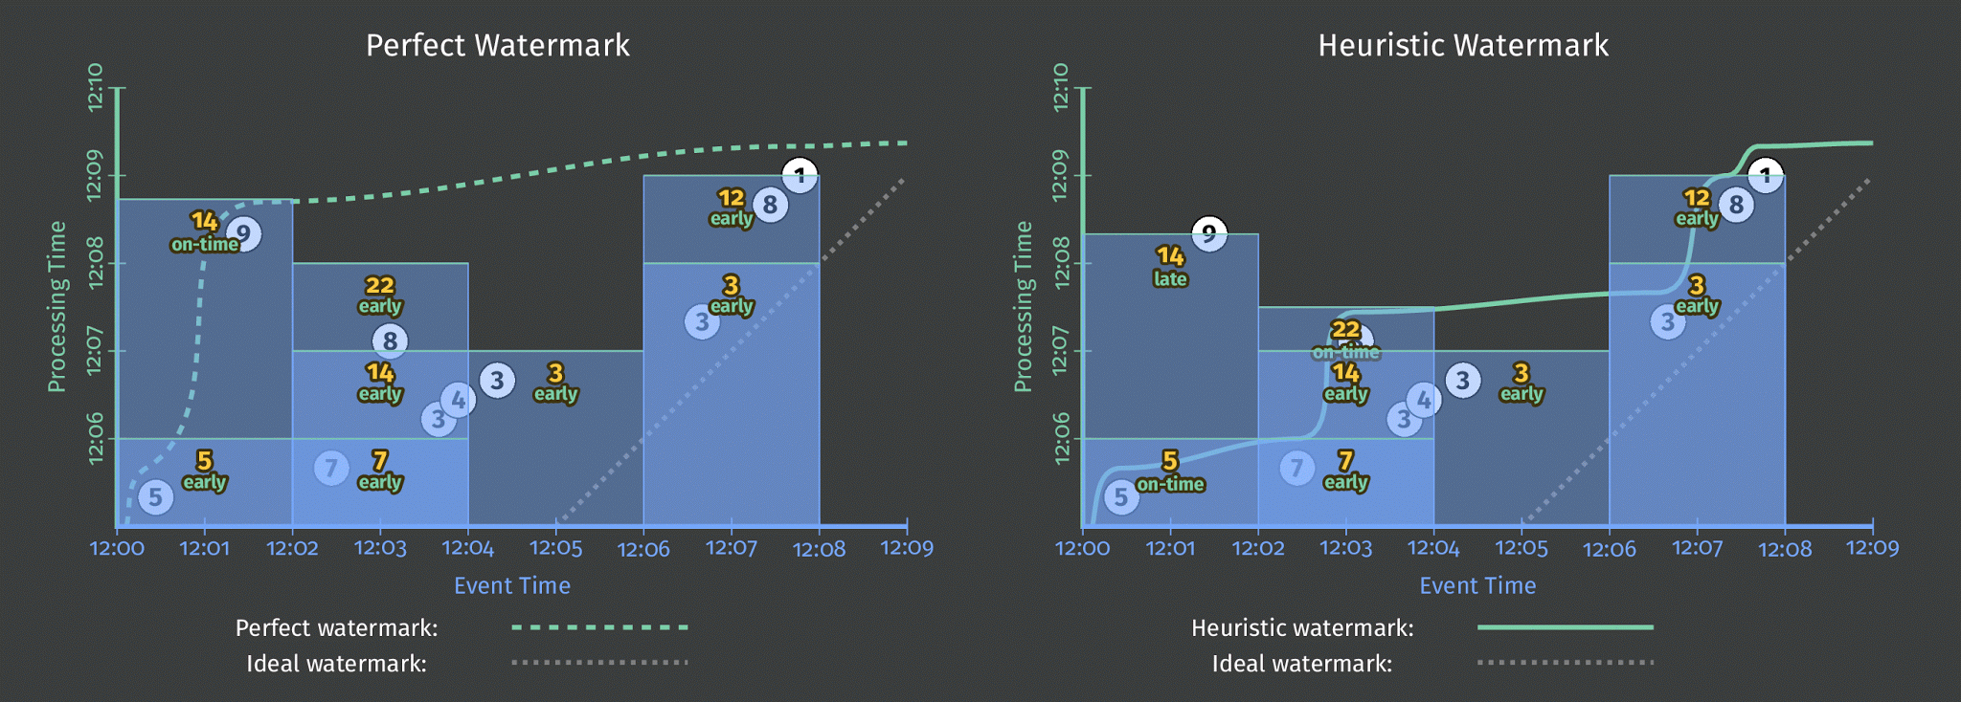
What Where When How
When: Early and Late Firings
Notes:
in all cases, able to get speculative results before the watermark.
now get results when watermark passes, but still handle late value 9 even with heuristic watermark
in this case, we accumulate across the multiple results per window
In the final window, we see and emit 3 but then still include that 3 in the next update of 12.
but this behavior around multiple firings is configurable...

Slide 76
The Beam Model: Asking the Right Questions
What are you computing?
Where in event time?
When in processing time are results produced?
How do refinements relate?
Accumulation Mode

Slide 77
How do refinements relate?
How should multiple outputs per window accumulate?
Appropriate choice depends on consumer.
3
2 more
Window.into(...)
.triggering(...)
.discardingFiredPanes()
5
5 more
2
3 more
Sum Per Key
Window.into(...)
.triggering(...)
.accumulatingFiredPanes()
new sum is 2
new sum is 7
new sum is 10

Slide 78
What Where When How
How do refinements relate? A more detail Example
How should multiple outputs per window accumulate?
Appropriate choice depends on consumer.
Firing | Elements
Speculative | [3]
Watermark | [5, 1]
Late | [2]
Last Observed
Total Observed
Discarding
3
6
2
2
11
Accumulating
3
9
11
11
23
Acc. & Retracting
3
9, -3
11, -9
11
11
(Accumulating & Retracting not yet implemented.)
Notes:
fire three times for a window -- a speculative firing with 3, watermark with two more values 5 and 1, and finally a late value 2.
one option is emit new elements that have come in since the last result. requires consumer to be able to do final sum
could produce the running sum every time. consumer may overcount
produce both the new running sum and retract the old one.

Slide 79
What Where When How
How: Add Newest, Remove Previous
PCollection<KV<String, Integer>> scores = input
.apply(Window.into(FixedWindows.of(Minutes(2))
.triggering(AtWatermark() .withEarlyFirings(AtPeriod(Minutes(1)))
.withLateFirings(AtCount(1)))
.accumulatingAndRetractingFiredPanes())
.apply(Sum.integersPerKey());
Notes:
use accumulating and retracting.

Slide 80
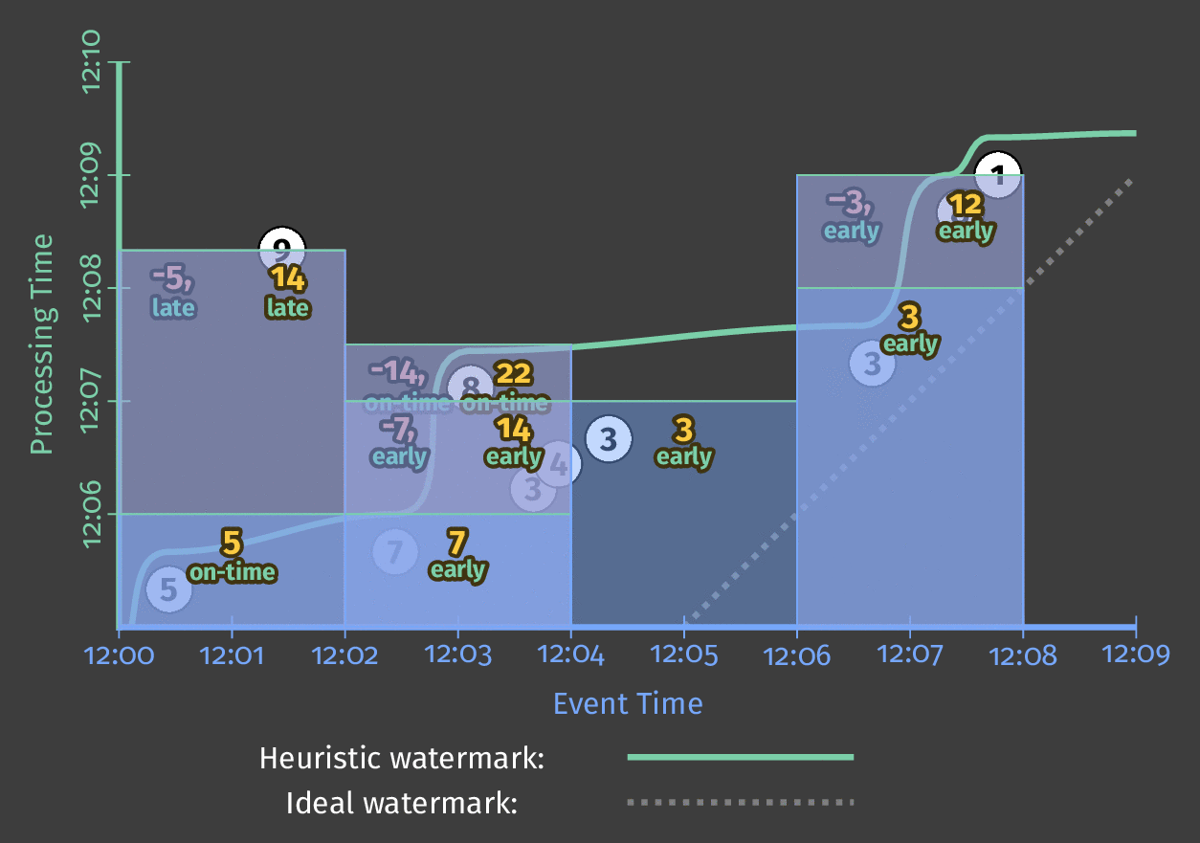
What Where When How
How: Add Newest, Remove Previous
Notes:
speculative results, on time results, and retractions.
now the final window emits 3, then retracts the 3 when emitting 12.
So those are the four questions...

Slide 81
What can this Generalized Stream Processing model (aka the Beam model) offer ?
Notes:
those are the four key questions
are they the right questions?

Slide 82
Correctness
Power
Composability
Flexibility
Modularity
What / Where / When / How
Notes:
the results we get are correct
this is not something we’ve historically gotten with streaming systems.

Slide 83
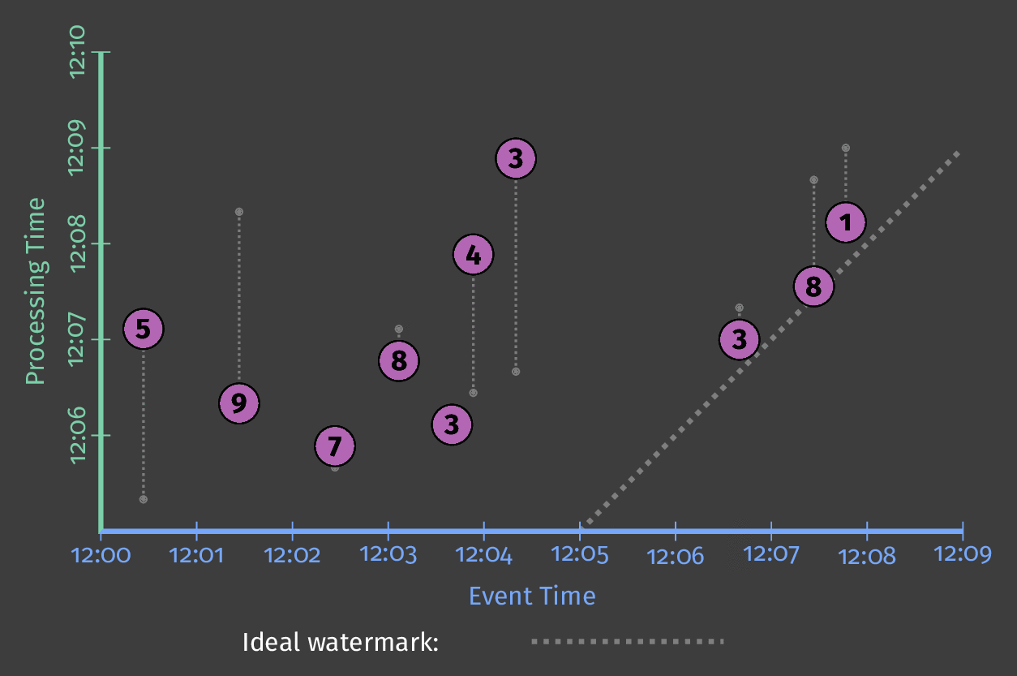
Distributed Systems are Distributed
Notes:
distributed systems are … distributed.
if the winds had been blowing from the east instead of the west, elements might have arrived in a slightly different order.

Slide 84
Processing Time Results Differ
Notes:
if we were aggregating based on processing time, this would result in different results for the two orderings.

Slide 85
Event Time Results are Stable
Notes:
aggregating based on event time may have different intermediate results
but the final results are identical across the two arrival scenarios.

Slide 86
Correctness
Power
Composability
Flexibility
Modularity
What / Where / When / How
Notes:
next, the abstractions can represent powerful and complex algorithms.

Slide 87
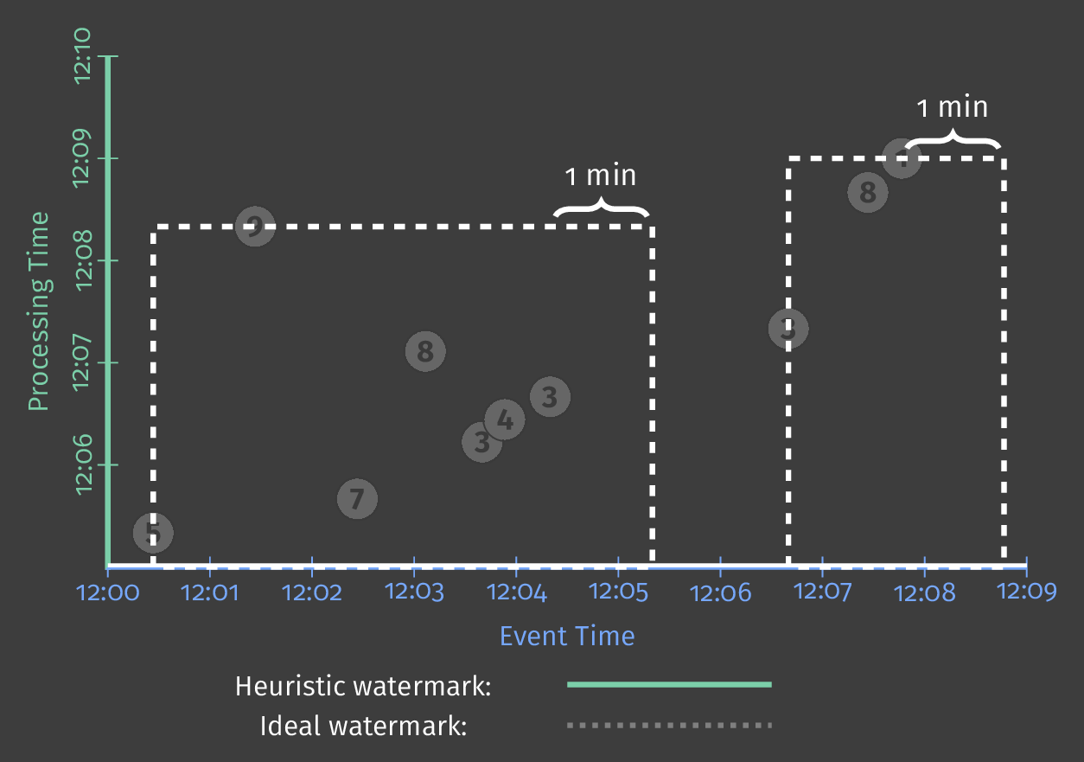
Identifying Bursts of User Activity
Notes:
earlier mentioned session windows -- burst of user activity
want to identify two groupings of points
in other words, Tyler was playing the game, got distracted by a squirrel, and then resumed his play.

Slide 88
Sessions
PCollection<KV<String, Integer>> scores = input
.apply(Window.into(Sessions.withGapDuration(Minutes(1))
.triggering(AtWatermark() .withEarlyFirings(AtPeriod(Minutes(1)))
.withLateFirings(AtCount(1))) .accumulatingAndRetractingFiredPanes())
.apply(Sum.integersPerKey());
Notes:
simple code change...

Slide 89
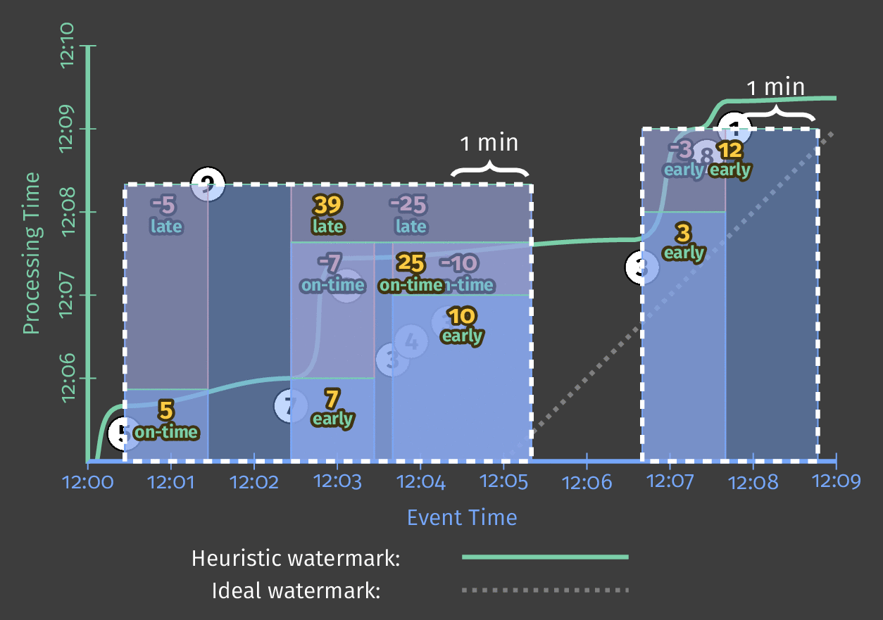
Identifying Bursts of User Activity
Notes:
now you can see the sessions being built over time
at first we see multiple components in the first session
not until late element 9 comes in that we realize it’s one big session

Slide 90
Correctness
Power
Composability
Flexibility
Modularity
What / Where / When / How
Notes:
next -- we’ve seen what the four questions can do.
what if we ask the questions twice?

Slide 91
Calculating Session Lengths
input
.apply(Window.into(Sessions.withGapDuration(Minutes(1))) .trigger(AtWatermark())
.discardingFiredPanes())
.apply(CalculateWindowLength()));
Notes:
code to calculate the length of a user session

Slide 92
Notes:
Remember that these graphs are always shown per key
here’s the graph calculating session lengths for Frances and the ones for Tyler

Slide 93
Calculating the Average Session Length
input
.apply(Window.into(Sessions.withGapDuration(Minutes(1))) .trigger(AtWatermark())
.discardingFiredPanes())
.apply(CalculateWindowLength()));
.apply(Window.into(FixedWindows.of(Minutes(2))) .trigger(AtWatermark()) .withEarlyFirings(AtPeriod(Minutes(1)))
.accumulatingFiredPanes())
.apply(Mean.globally());
Notes:
now lets take those session lengths per user
ask the questions again
this time using fixed windows to take the mean across the entire collection...

Slide 94
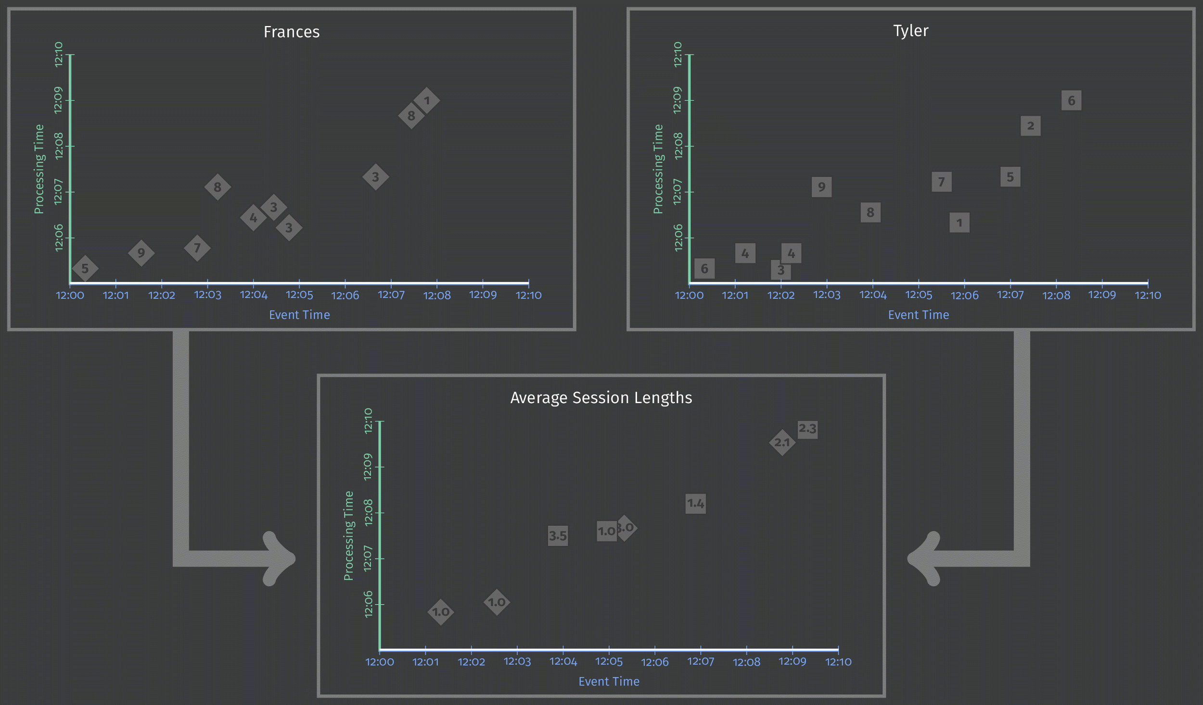
Notes:
Now calculating the average length of all sessions that ended in a given time period
if we rolled out an update to our game, this would let us quickly understand if that resulted a change in user behavior
if the change made the game less fun, we could see a sudden drop in how long users play

Slide 95
Correctness
Power
Composability
Flexibility
Modularity
What / Where / When / How
Notes:
ok… flexibility for covering all sorts of uses cases

Slide 96
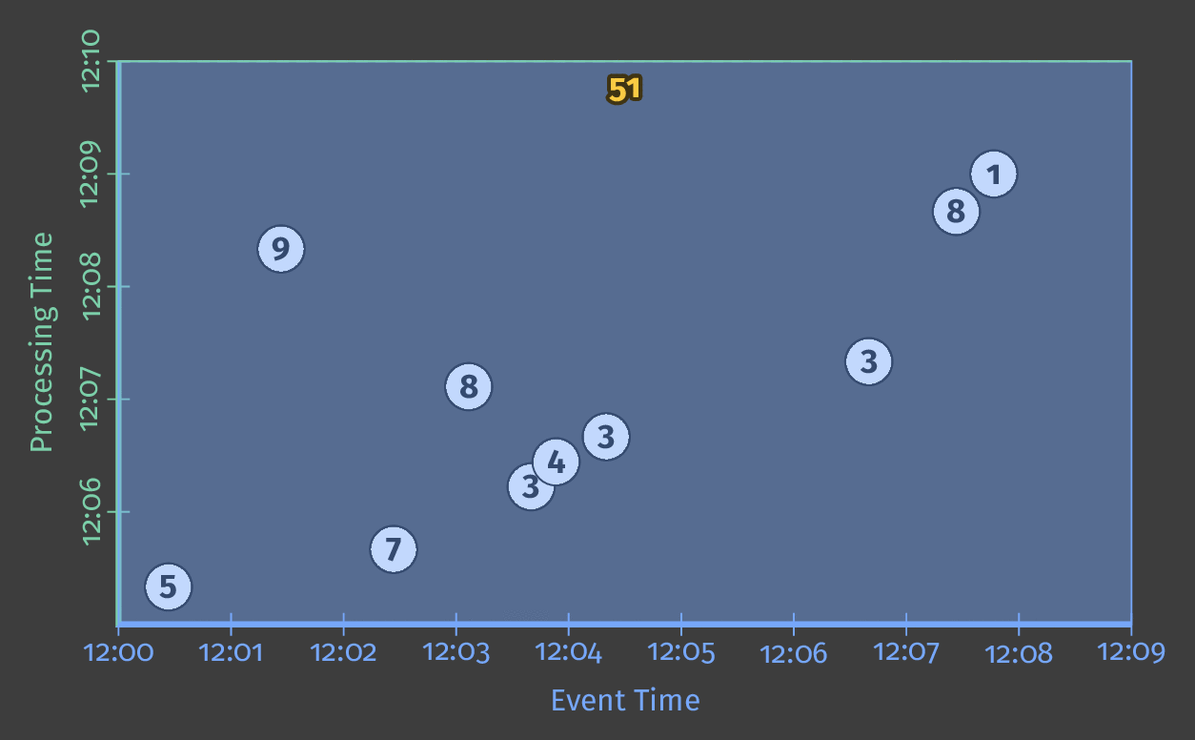
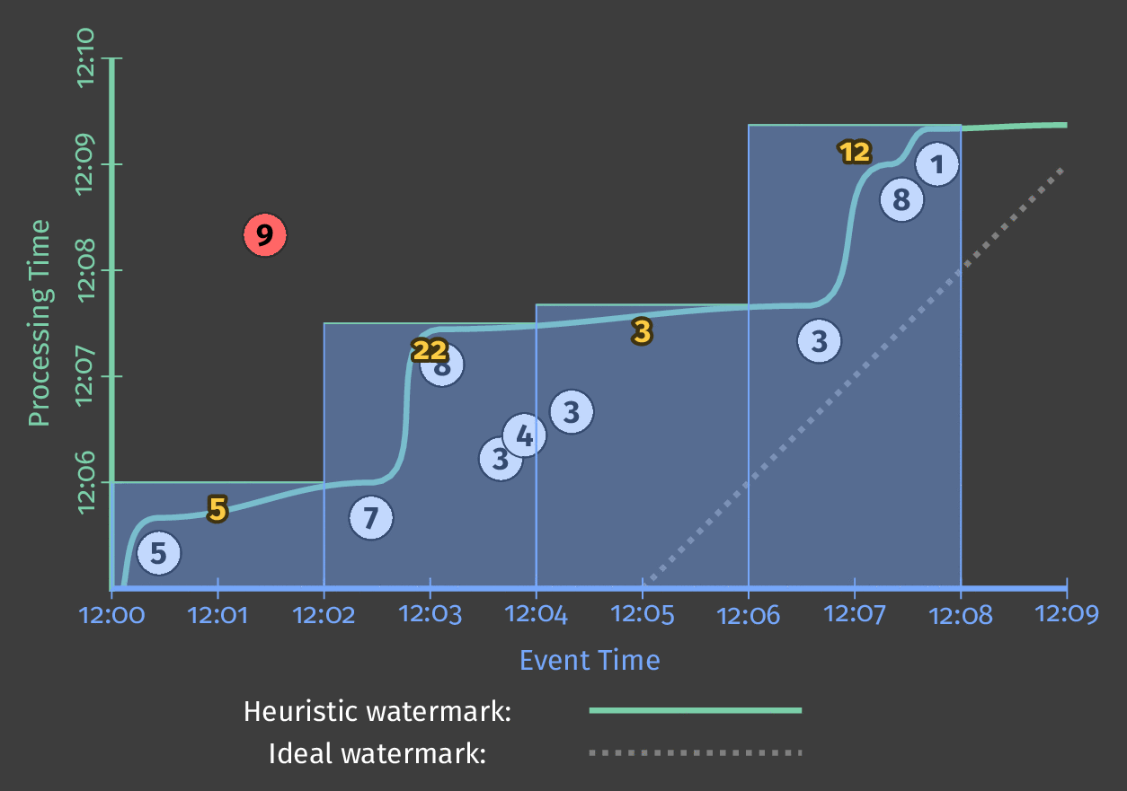
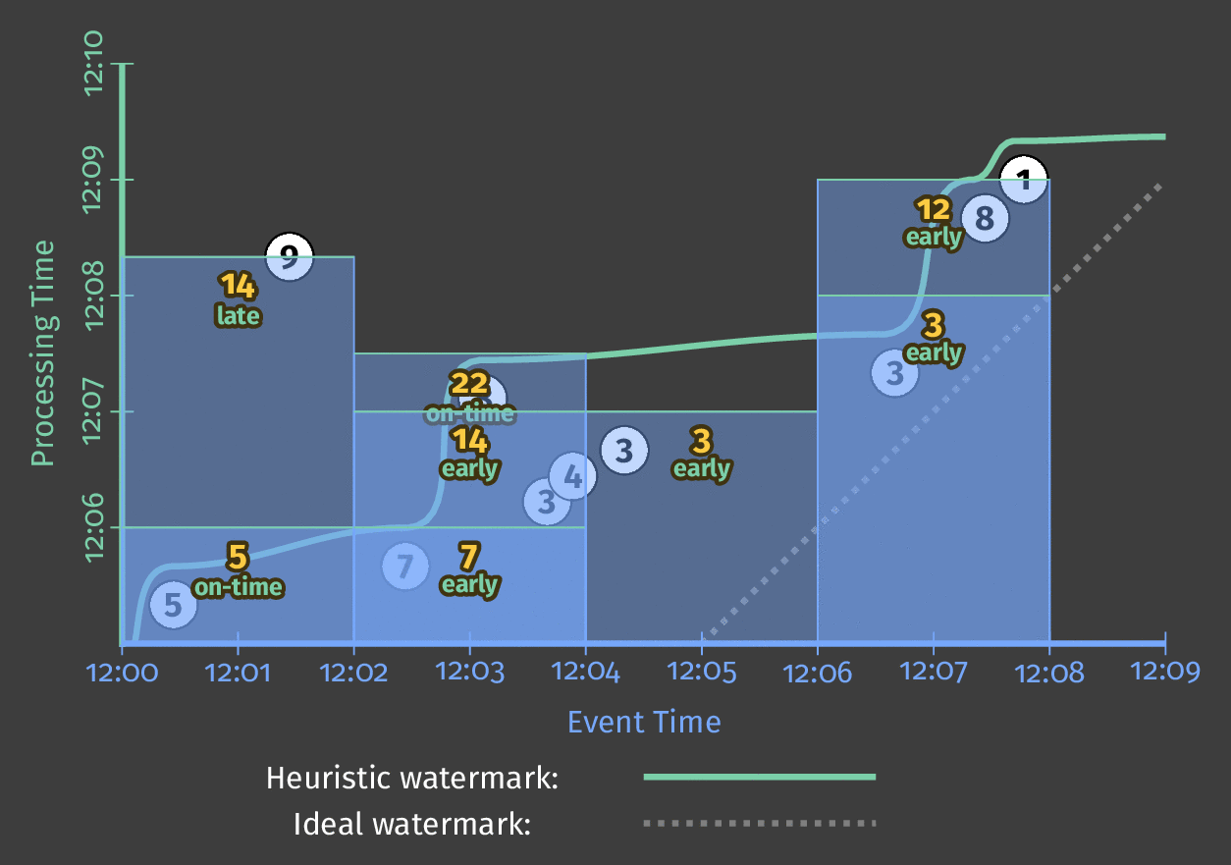
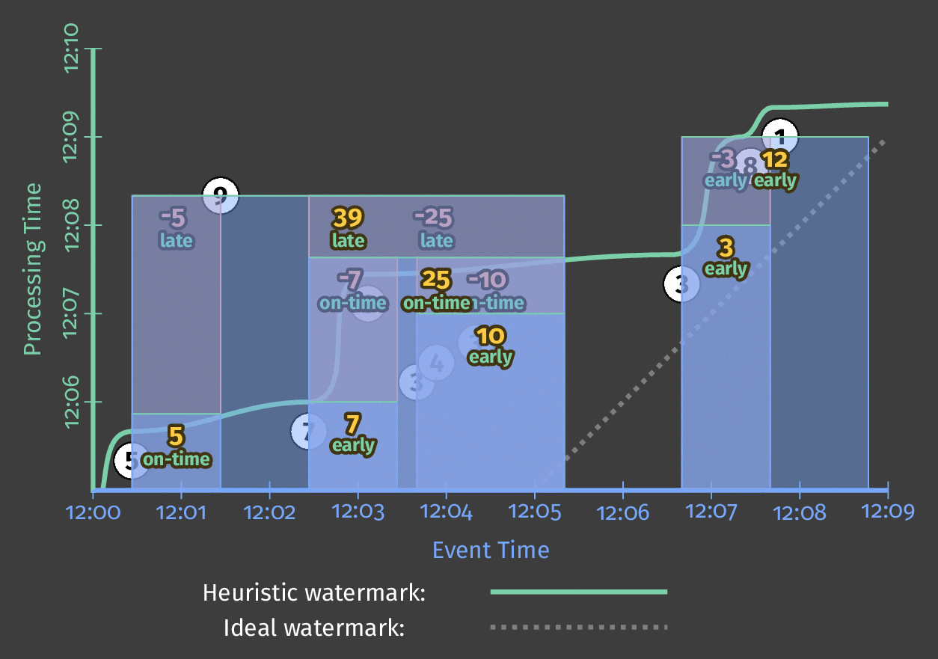
1.Classic Batch
2. Batch with Fixed Windows
3. Streaming
4. Streaming with Speculative + Late Data
5. Streaming With Retractions
6. Sessions
Notes:
By tuning our what/where/when/how knobs, we’ve covered everything from classic batch… to sessions

Slide 97
Correctness
Power
Composability
Flexibility
Modularity
What / Where / When / How
Notes:
And not only that, we do so with lovely modular code

Slide 98
PCollection<KV<String, Integer>> scores = input
.apply(Sum.integersPerKey());
PCollection<KV<String, Integer>> scores = input
.apply(Window.into(FixedWindows.of(Minutes(2)))
.apply(Sum.integersPerKey());
PCollection<KV<String, Integer>> scores = input
.apply(Window.into(FixedWindows.of(Minutes(2))
.triggering(AtWatermark())) .apply(Sum.integersPerKey());
1.Classic Batch
2. Batch with Fixed Windows
3. Streaming
PCollection<KV<String, Integer>> scores = input
.apply(Window.into(FixedWindows.of(Minutes(2))
.triggering(AtWatermark() .withEarlyFirings(AtPeriod(Minutes(1)))
.withLateFirings(AtCount(1))) .apply(Sum.integersPerKey());
PCollection<KV<String, Integer>> scores = input
.apply(Window.into(FixedWindows.of(Minutes(2))
.triggering(AtWatermark() .withEarlyFirings(AtPeriod(Minutes(1)))
.withLateFirings(AtCount(1))) .accumulatingAndRetractingFiredPanes())
.apply(Sum.integersPerKey());
PCollection<KV<String, Integer>> scores = input
.apply(Window.into(Sessions.withGapDuration(Minutes(2))
.triggering(AtWatermark() .withEarlyFirings(AtPeriod(Minutes(1)))
.withLateFirings(AtCount(1))) .accumulatingAndRetractingFiredPanes())
.apply(Sum.integersPerKey());
4. Streaming with Speculative + Late Data
5. Streaming With Retractions
6. Sessions
Notes:
all these uses cases -- and we never changed our core algorithm
just integer summing here, but the same would apply with much more complex algorithms too

Slide 99
Correctness
Power
Composability
Flexibility
Modularity
What / Where / When / How
Notes:
so there you go -- 5 reasons that these 4 questions are awesome

Slide 100
Apache Beam
Notes:
discussed the use case
introduced the four questions in the Beam model
shown they are the right questions
… now let’s get concrete and see how we got to this model and where we’re going

Slide 101
A Beam Computational Pipeline
PTransform
Pipeline
PCollection
(bounded or unbounded)

Slide 102
The Beam Vision
Cloud Dataflow: fully managed
Apache Flink
local, on-prem, cloud
Java
input.apply(
Sum.integersPerKey())
Apache Spark
local, on-prem, cloud
Sum Per Key
Python
Apache Apex
local, on-prem, cloud
input | Sum.PerKey()
Apache Gearpump (incubating)
⋮
⋮

Slide 103
What your (Java) Beam code Looks Like
Pipeline p = Pipeline.create(options);
p.apply(TextIO.Read.from("gs://dataflow-samples/shakespeare/*"))
.apply(FlatMapElements.via(line -> Arrays.asList(line.split("[^a-zA-Z']+"))))
.apply(Filter.byPredicate(word -> !word.isEmpty()))
.apply(Count.perElement())
.apply(MapElements.via(count -> count.getKey() + ": " + count.getValue())
.apply(TextIO.Write.to("gs://..."));
p.run();

Slide 104
The Evolution of Beam
Colossus
BigTable
PubSub
Dremel
Google Cloud Dataflow
Spanner
Megastore
Millwheel
Flume
MapReduce
Apache Beam
Notes:
Google published the original paper on MapReduce in 2004 -- fundamentally change the way we do distributed processing.
<animate> Inside Google, kept innovating, but just published papers
<animate> Externally the open source community created Hadoop. Entire ecosystem flourished, partially influenced by those Google papers.
<animate> In 2014, Google Cloud Dataflow -- included both a new programming model and fully managed service
share this model more broadly -- both because it is awesome and because users benefit from a larger ecosystem and portability across multiple runtimes.
So Google, along with a handful of partners donated this programming model to the Apache Software Foundation, as the incubating project Apache Beam...

Slide 105
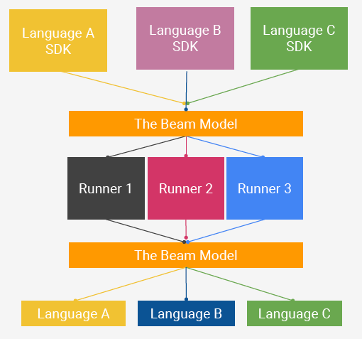
Apache Beam Technical Vision
The Beam Model: the abstractions at the core of Apache Beam
End users: who want to write pipelines or transform libraries in a language that’s familiar.
SDK writers: who want to make Beam concepts available in new languages.
Runner writers: who have a distributed processing environment (on-prem/ cloud, open-source/ closed-source) and want to support Beam pipelines
A Runner platform (e.g. Flink) may also make the power of the Beam model available to native users of the platform by extending the platform’s native APIs.
Beam Java
Other
Languages
Beam Python
Beam Model: Pipeline Construction
Runner A
Cloud Dataflow
Runner B
Beam Model: Fn Runners
Execution
Execution
Execution
Notes:
fully support three different categories of users
End users who want to write data processing pipelines
Includes adding value like additional connectors
Additionally, support community-sourced SDKs and runners
Each community has very different sets of goals and needs.
having a vision and reaching it are two different things...

Slide 106
What is Part of Apache Beam?
The Beam Model: What / Where / When / How
SDKs for writing Beam pipelines -- Java and Python
Runners for Existing Distributed Processing Backends
Apache Flink
Apache Spark
Google Cloud Dataflow
Direct runner for local development and testing
In development: Apache Gearpump and Apache Apex
Notes:
Today, Apache Beam includes
the core unified programming model
the initial Java SDK that we developed as part of Cloud Dataflow
and, most important for portability, multiple runners that can execute Beam pipelines on existing distributed process backends.
but our longer term goals...

Slide 107
Apache Beam Technical Vision
The Beam Model: the abstractions at the core of Apache Beam
End users: who want to write pipelines or transform libraries in a language that’s familiar.
SDK writers: who want to make Beam concepts available in new languages.
Runner writers: who have a distributed processing environment (on-prem/ cloud, open-source/ closed-source) and want to support Beam pipelines
A Runner platform (e.g. Flink) may also make the power of the Beam model available to native users of the platform by extending the platform’s native APIs.
Beam Java
Other
Languages
Beam Python
Beam Model: Pipeline Construction
Runner A
Cloud Dataflow
Runner B
Beam Model: Fn Runners
Execution
Execution
Execution
Notes:
fully support three different categories of users
End users who want to write data processing pipelines
Includes adding value like additional connectors
Additionally, support community-sourced SDKs and runners
Each community has very different sets of goals and needs.
having a vision and reaching it are two different things...

Slide 108
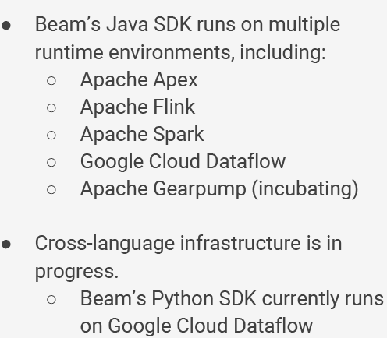
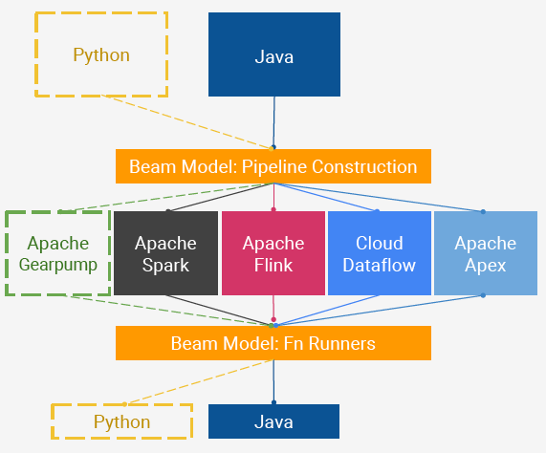
Beam’s Reality: as of April 2018
Notes:
fully support three different categories of users
End users who want to write data processing pipelines
Includes adding value like additional connectors
Additionally, support community-sourced SDKs and runners
Each community has very different sets of goals and needs.
having a vision and reaching it are two different things...

Slide 109
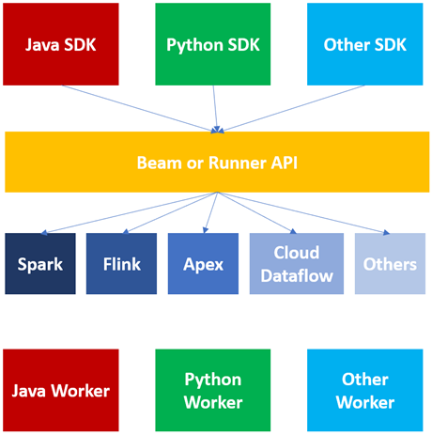
Beam’s Reality: as of 2022
Notes:
fully support three different categories of users
End users who want to write data processing pipelines
Includes adding value like additional connectors
Additionally, support community-sourced SDKs and runners
Each community has very different sets of goals and needs.
having a vision and reaching it are two different things...

Slide 110
Notes:
fully support three different categories of users
End users who want to write data processing pipelines
Includes adding value like additional connectors
Additionally, support community-sourced SDKs and runners
Each community has very different sets of goals and needs.
having a vision and reaching it are two different things...
https://flink.apache.org/ecosystem/2020/02/22/apache-beam-how-beam-runs-on-top-of-flink.html

Slide 111
Example Beam Runners
Notes:
fully support three different categories of users
End users who want to write data processing pipelines
Includes adding value like additional connectors
Additionally, support community-sourced SDKs and runners
Each community has very different sets of goals and needs.
having a vision and reaching it are two different things...

Slide 112
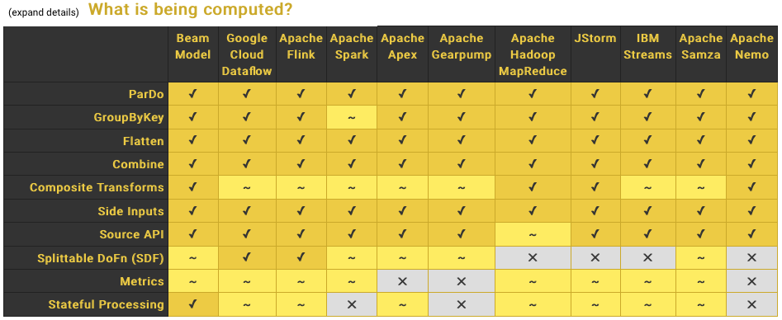
Comparing Runner Capabilities
Latest version available at:
http://beam.apache.org/
documentation/runners/
capability-matrix/
Notes:
https://beam.apache.org/documentation/runners/capability-matrix/
The Beam model is attempting to generalize semantics -- will not align perfectly with all possible runtimes.
Started categorizing the features in the model and the various levels of runner support.
This will help users understand mismatches like using event time processing in Spark or exactly once processing with Samza.

Slide 113
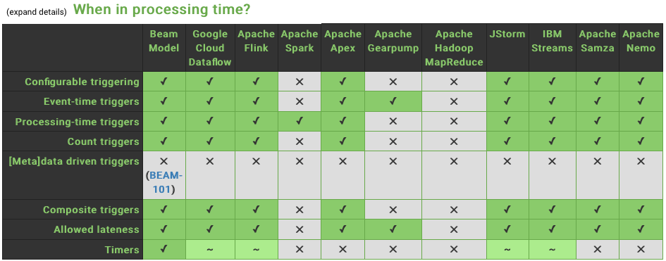
Comparing Runner Capabilities
Notes:
The Beam model is attempting to generalize semantics -- will not align perfectly with all possible runtimes.
Started categorizing the features in the model and the various levels of runner support.
This will help users understand mismatches like using event time processing in Spark or exactly once processing with Samza.

Slide 114
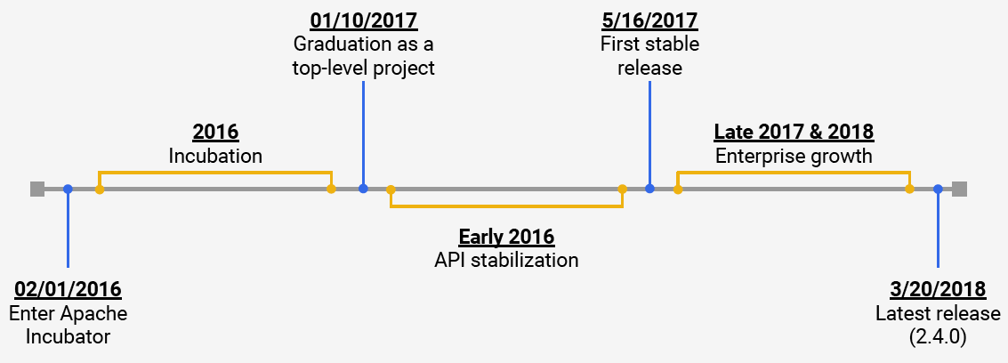
Progress of Apache Beam
3/4/2022
Latest release
(2.37.0)
Notes:
Beam entered incubation in early February.
Once we dumped in the initial 48k lines ofcode, there was a period of de-googlification and generalization.
We’re now getting pretty close to having different runners seemlessly running Beam pipelines.
This will give users the flexibility to choose the Beam runner that’s best for them.
To do that they need to understand what different runners can do...
https://2021.beamsummit.org/sessions/state-apache-beam/

Slide 115
Milestones of Apache Beam (circa: Aug 2021)
Notes:
Beam entered incubation in early February.
Once we dumped in the initial 48k lines ofcode, there was a period of de-googlification and generalization.
We’re now getting pretty close to having different runners seemlessly running Beam pipelines.
This will give users the flexibility to choose the Beam runner that’s best for them.
To do that they need to understand what different runners can do...
https://2021.beamsummit.org/sessions/state-apache-beam/

Slide 116
Learn More !
Free Book on Key Streaming Concepts and Apache Beammin
http://asiandatascience.com/wp-content/uploads/2018/01/WP_EN_BD_OReilly_Streaming_Systems.pdf
Two Excellent Articles on Streaming Models and Beamming gndamentals: The World Beyond Batch 101 http://www.oreilly.com/ideas/the-world-beyond-batch-streaming-101 http://www.oreilly.com/ideas/the-world-beyond-batch-streaming-102
Apache Beam http://beam.apache.org
Cloud Dataflow
http://cloud.google.com/dataflow/
Follow @ApacheBeam on Twitter
Beam Summit: https://2022.beamsummit.org

